Slide 1
Final Year Project: Initial Progress
Marij Qureshi 16th Jan 2020
Robust Optimisation of Composite Panels
Points to Cover:
Preparatory work
Research Direction
Software Problems
Project Plan
Next Steps

Slide 2
Preparatory Work
Refreshing and developing analysis skills
MATLAB, Python
Software set-up and exploration
Abaqus, Isight
Literature Overview
Composite structural problems
Robust/Reliable design
Optimisation methods – conjugate gradient
Notes:
Post-buckling reliability design (vary lay-up)
Chapter 7: Robust Multilevel Design Optimization of Composite Panels
Robust and Reliability-Based Design Optimization of a Composite Floor Beam

Slide 3
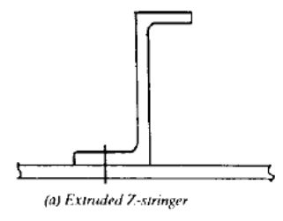
Research Direction
Workflow test case
Cantilever square beam (end point load)
Optimise side length for min. mass for target deflection
Main test case (idea)
Mono-string stiffened panel
Buckling (main/only failure mode?)
Optimise geometry of z-stringer (continuous)
Further design studies studies (ideas)
Lay-up
Material (fibres/matrix)
Load Cases
Optimisation techniques

Slide 4
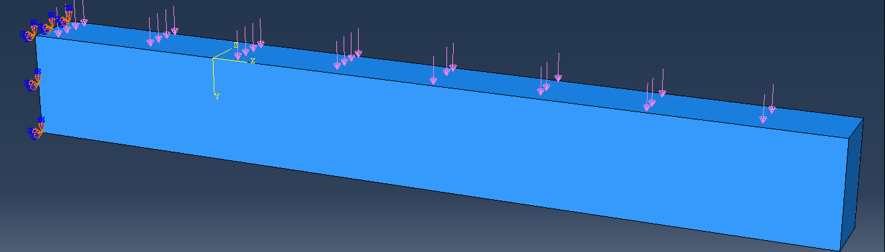
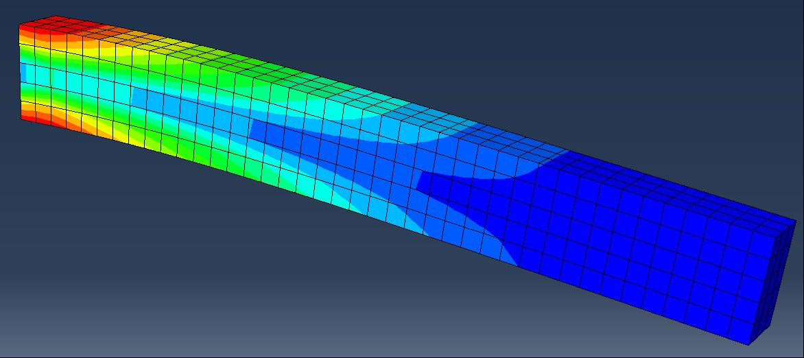
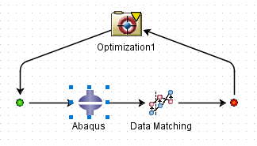
Software problems
Roadblocks
Abaqus + Isight Installation
Personal computer issues
Abaqus design + simulation
Abaqus parameter output
Isight parameter input
Isight solver flow setup
Untested
Testing
Question: Best places for tech. support? (Simulia – Imperial license?)

Slide 5
Project plan
Workflow Test Case
Main Test Case
Design Studies
Computation
Final Report Work
Structural Theory
Optimisation Methods
Results Analysis
Analytical Work + Research
Wks 17-19
Wks 1-3
Wks 4-7
Wks 9-16
Week | 1 | 2 | 3 | 4 | 5 | 6 | 7 | 8 | 9 | 10 | 11 | 12 | 13 | 14 | 15 | 16 | 17 | 18 | 19
Month | Jan |  | Feb |  |  |  | Mar |  |  |  |  | Apr |  |  |  | May

Slide 6
Next steps
Solve Isight parameter reading problems
Try to get Isight working on personal computer
Further reading on monostring structural theory

Slide 7
